Slide 1

Media Bazaar
Class: S-CB-S2-CMK
Group: 4
Team “BulCari” members:
Tony Jiang
Stoycho Stoychev
Veronika Valeva
Stela Trencheva

Slide 2



Content
Functionalities
Demo
Questions

Slide 3
Functionalities
1. Employee Management
Employee CRUD, info, contracts.
Automatic schedule
Holiday requests
Employee statistics

Slide 4
Functionalities
2. Product Management
Product CRUD, info
Departments
Cashier app
Restock requests
Product statistics

Slide 5
Functionalities
3. Website
Schedule
Marking availability
Request holidays
Edit personal info

Slide 6
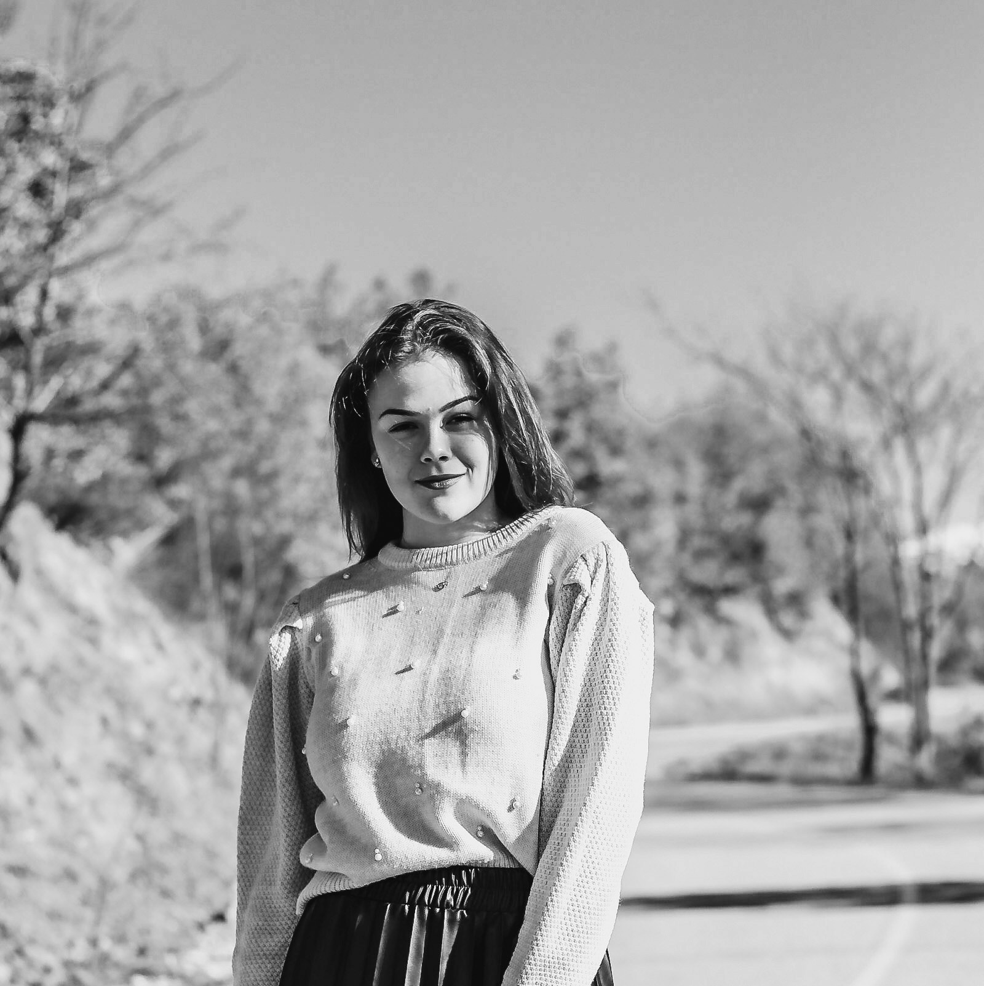
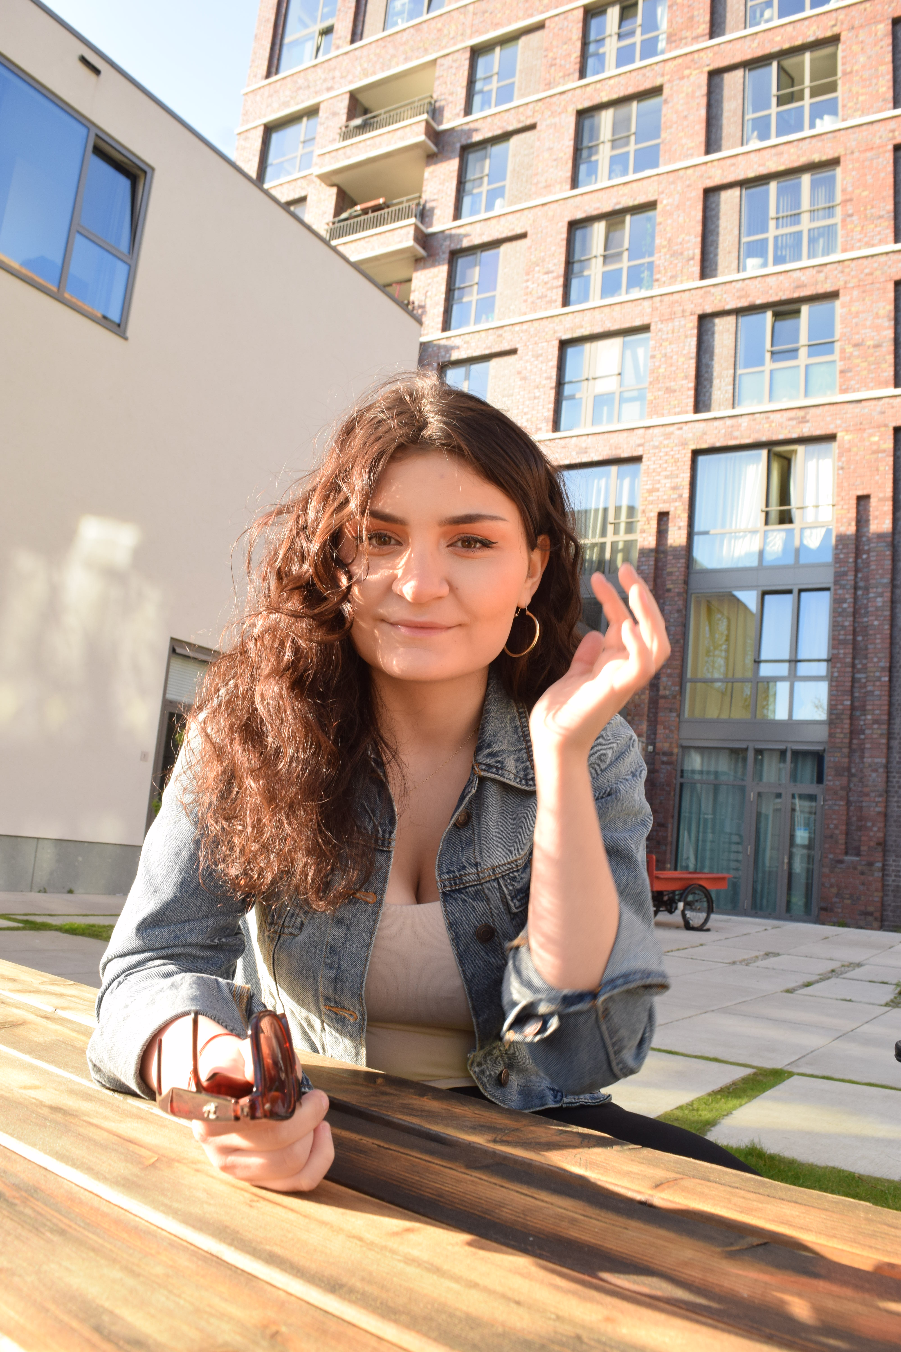
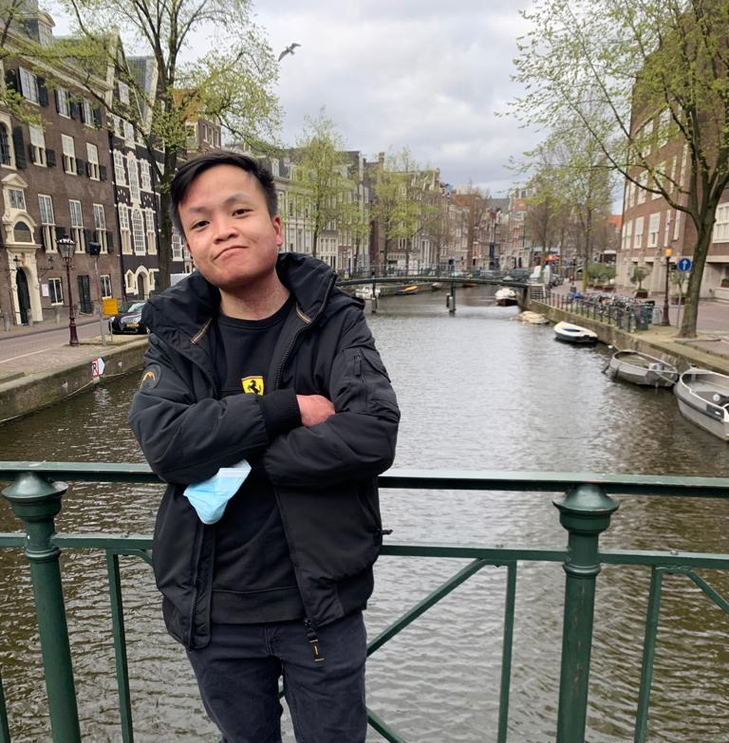
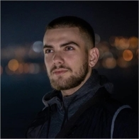
Our Team
BULCARI
Stela Trencheva
from Bulgaria
Veronika Valeva
from Bulgaria
Tony Jiang
from Caribbean
Stoycho Stoychev
from Bulgaria

Slide 7
Thank you!
Feel free to ask
Questions

